Slide 1
LEAST SQUARE FITTING

Slide 2
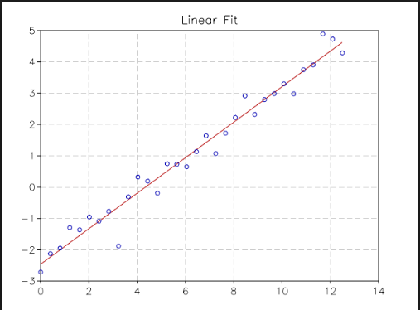

Slide 3
Line of best fit
A line of best fit is a straight line that is the best approximation of the given set of data.
It is used to study the nature of the relation between two variables.
A line of best fit can be roughly determined using an eyeball method by drawing a straight line on a scatter plot so that the number of points above the line and below the line is about equal (and the line passes through as many points as possible).
A more accurate way of finding the line of best fit is the least square method .

Slide 4
Least squares
The least squares method is a form of mathematical regression analysis that finds the line of best fit for a dataset, providing a visual demonstration of the relationship between the data points. Each point of data is representative of the relationship between a known independent variable and an unknown dependent variable.

Slide 5
Hooke’slaw
It states that resolving force of a spring is directly proportional to a small displacement.
Mathematically:- F=-kx
Where x is measure of displacement , k is constant of proportionality and specific for each spring.

Slide 6
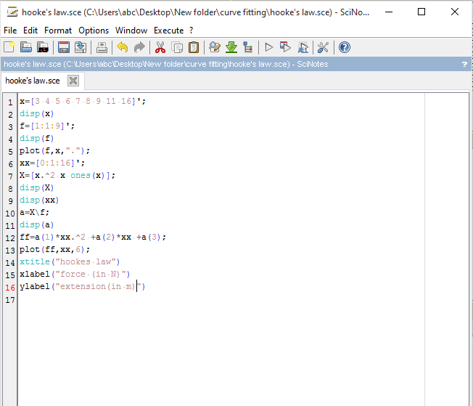

Slide 7
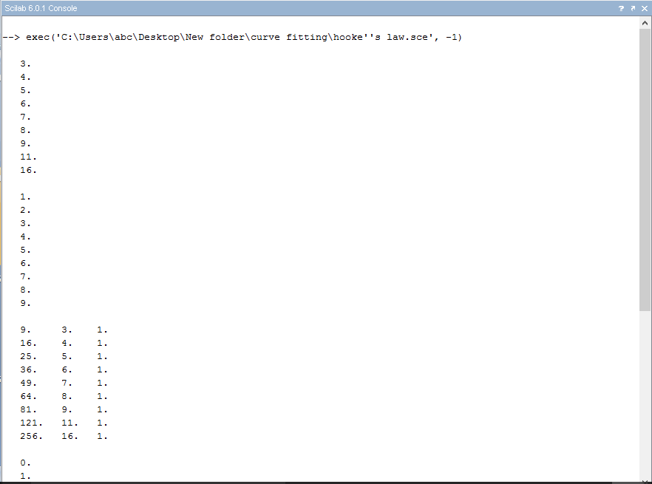

Slide 8
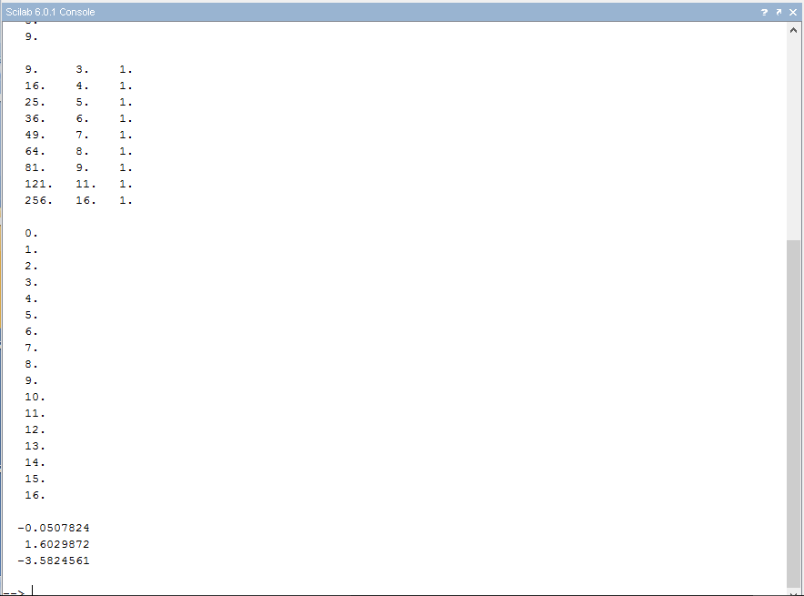

Slide 9
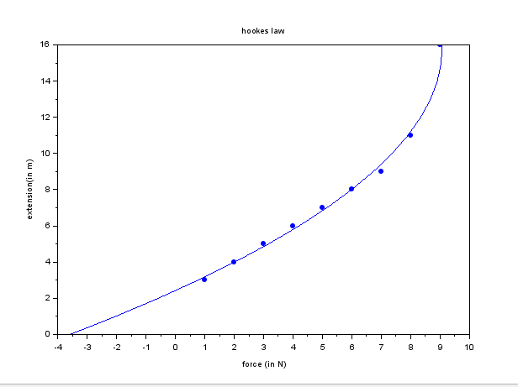

Slide 10
Ohm’s law
It states that the voltage across two points of a conductor is directly proportional to the current flowing between same two points.
Mathematically :-
V=IR

Slide 11
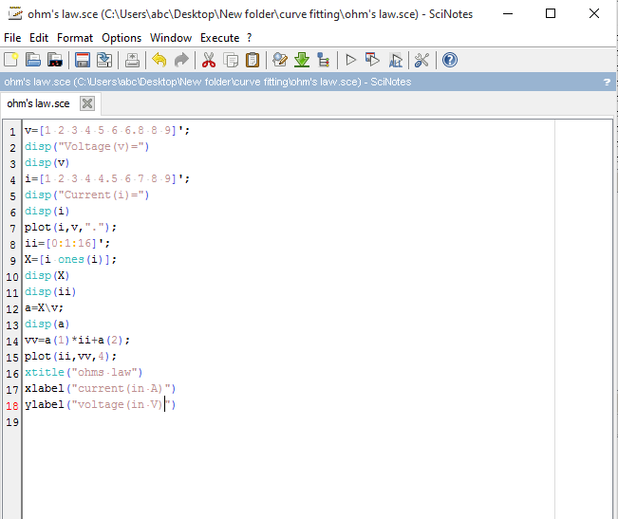

Slide 12
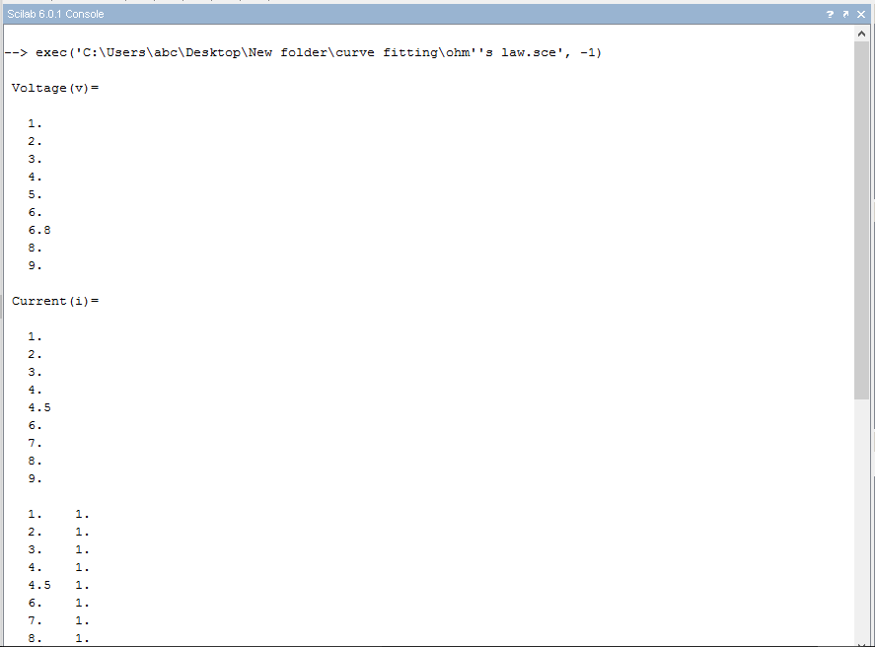

Slide 13
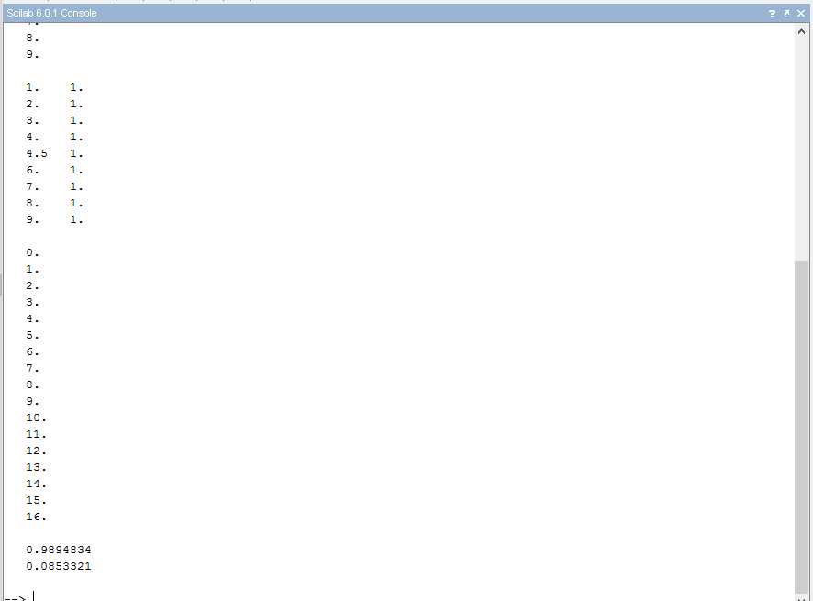

Slide 14
